Slide 1

CAPSTONE PROJECT
Automation Testing Framework Architecture
Cinema Booking Web with Playwright & TypeScript
STUDENT: Nguyễn Thị Thuỳ Trang
COURSE: Testing 15 - Automation Testing

Slide 2


Project Objectives
POM Architecture: Implement a scalable Page Object Model pattern.
Playwright Framework: Build a robust framework using TypeScript.
Maintainability: Ensure code is reusable and easy to update.
Automation Coverage: Target ≥ 40% functional coverage.
End-to-End Flow: Automate the complete booking journey.

Slide 3
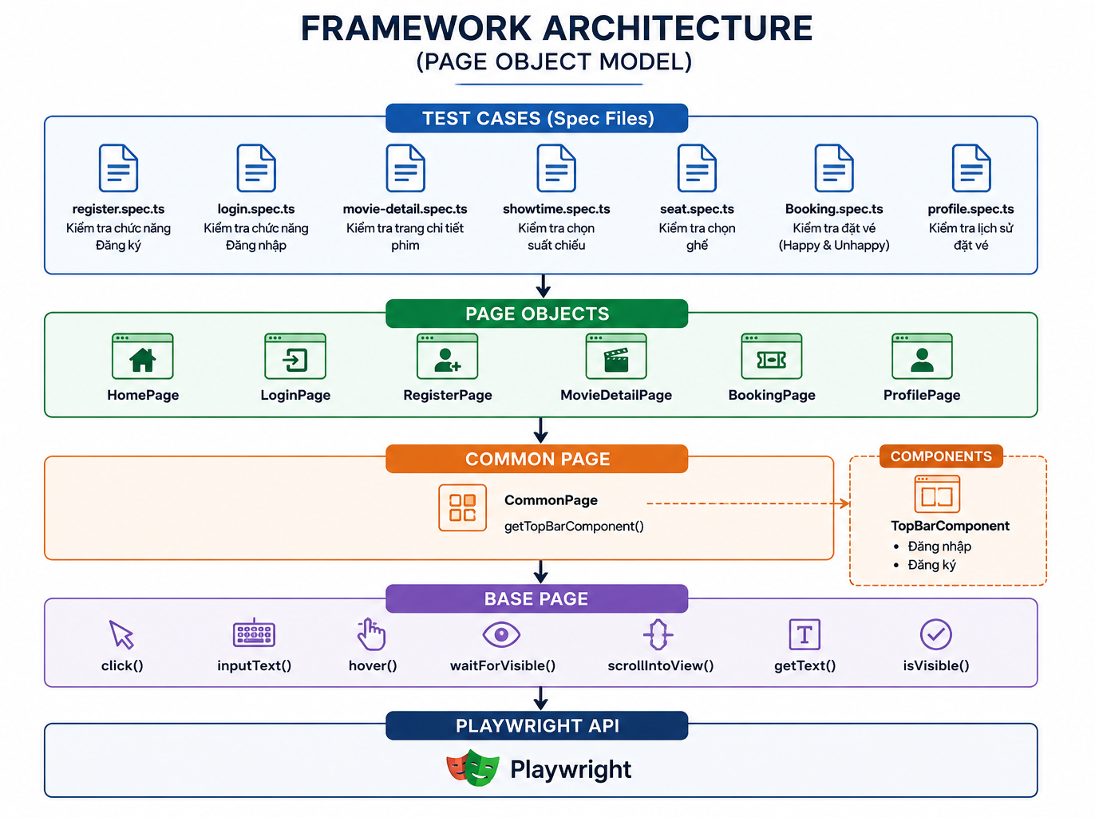

Framework Architecture
Logic Layering:
Test Spec: Pure test steps & assertions.
Page Objects: Locators & page-specific actions.
Common Page: Reusable global UI components.
Base Page: Low-level Playwright wrappers (click, type).

Slide 4
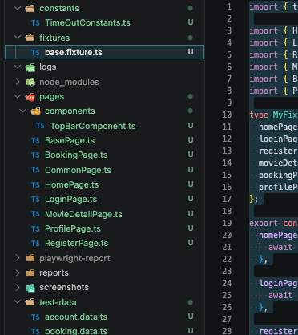
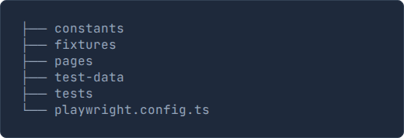
Project Structure
Our repository is organized for clarity and separation of concerns:

Slide 5
Folder Responsibilities
Folder | Functionality
tests | Main test kịch bản (.spec.ts files)
pages | Locators mapping and UI interactions
components | Reusable widgets like Top Bar or Modals
fixtures | Automated Page Object instantiation
test-data | JSON files for login and movie data
constants | Wait times, URLs, and global strings

Slide 6






Core Spec Files
Auth Specs
Booking Specs
Account Specs
register.spec.ts login.spec.ts
movie-detail.spec.ts showtime.spec.ts seat.spec.ts
booking.spec.ts profile.spec.ts
Each spec targets a single functional module for atomic testing.

Slide 7


Page Object Mapping
Foundation Pages
Functional Pages
•
BasePage.ts (Wrappers)
•
LoginPage.ts
•
CommonPage.ts (Navigation)
•
RegisterPage.ts
•
HomePage.ts (Discovery)
•
MovieDetailPage.ts
•
BookingPage.ts

Slide 8


Test Scenarios
Happy Path
Unhappy Path
Verified successful flows:
Error handling validation:
•
Valid Registration & Login
•
Invalid data format entry
•
Movie detail navigation
•
Incorrect credential attempts
•
Showtime & Seat selection
•
Booking without seat selection
•
Successful checkout flow
•
Session timeout handling

Slide 9
Automation Coverage
Feature Module | Status | Automation Mode
User Authentication | ✔ Completed | UI Integration
Movie Catalog | ✔ Completed | UI Integration
Booking System | ✔ Completed | End-to-End
User History | ✔ Completed | UI Integration

Slide 10

Execution Demo Flow
Login
Pick Seats
History
Register
Select Movie
Booking
$ npx playwright test --project=chromium
Running 7 tests using 4 workers...

Slide 11
Framework Advantages
Playwright Power: Auto-waiting and trace viewer integration.
Async Execution: Fast TypeScript execution with async/await.
Maintenance: Single source of truth for all locators.
Headless Mode: CI/CD ready for automated pipelines.
Fixture Injection: Clean setup for every test case.
Data Isolation: Separate JSON data per environment.

Slide 12




Questions?
Project Summary & Final Achievements
POM successfully implemented
Framework is scalable for future features
Email: contact@example.com
GitHub: /playwright-cybersoft

